Slide 1


Prepared by group 1
EMPLOYEE RETENTION
Analyzing Employee Data to Drive Strategic HR Decisions

Slide 2

Team Members
Sunkara Geya Vineela
Latchupatula Jyotshna
Sanchita Sanjay Jadhav
Tellam Tarunya
Swajal Sandeep Aparadh
Shaikh Tanaz Bano Mansoor Hussain

Slide 3


CONTENT
01
02
03
04
Introduction
Data Overview
Objectives KPIs
Process
05
06
07
08
Analysis
Recommendations and
Insights
Conclusion
Dashboard

Slide 4
Introduction
Purpose:
To understand workforce trends, employee behavior, and attrition patterns using data-driven insights.
Importance of HR Analytics:
Supports strategic HR decisions, enhances retention, and improves employee experience.

Slide 5

Data Overview
•Source: HR dataset containing demographic, work-related, and attrition data
•Size: ~50,000 records
•Key Columns:
- Age, Gender, Department, Job Role
- Attrition (Yes/No), Monthly Income, Hourly Rate
- Years at Company, Years Since Last Promotion
- Work Life Balance, Education, etc.

Slide 6
Objectives: KPIs
Attrition Rate vs Monthly Income
1
Avg Hourly Rate of Research Scientists
by gender
2
Attrition Rate vs Years Since Last Promotion
3
Avg Attrition Rate for All Departments
4
Avg Working Years by Department
5
Job Role vs Work-Life Balance
6

Slide 7





Process Overview
RECOMMENDATIONS AND STRATEGIC PLANNING
DATA EXPLORATION
KPI DEVELOPMENT
DATA COLLECTION
DATA VISUALIZATION
INSIGHTS AND PATTERN IDENTIFICATION

Slide 8
Analysis – General Stats
Total Number of Employees
Definition: The total count of employees in the organization (both active and those who have left).
Value: 50,000
Purpose: Helps define the scope of the analysis and acts as the denominator for attrition metrics.
Total Employees Present
Definition: Number of current active employees.
Value: 24,895
Purpose: Tracks workforce strength and helps evaluate resource availability.

Slide 9
Analysis – General Stats
Total Number of Employees Left
Definition: Employees who have left the company over the observed period.
Value: 25,105
Purpose: Helps compute attrition rate and assess retention health.
Total Attrition Rate
Definition: The percentage of employees who left the organization.
Value: 50.21%
Purpose: Indicates overall turnover health. A high rate may signal organizational or culture issues.

Slide 10
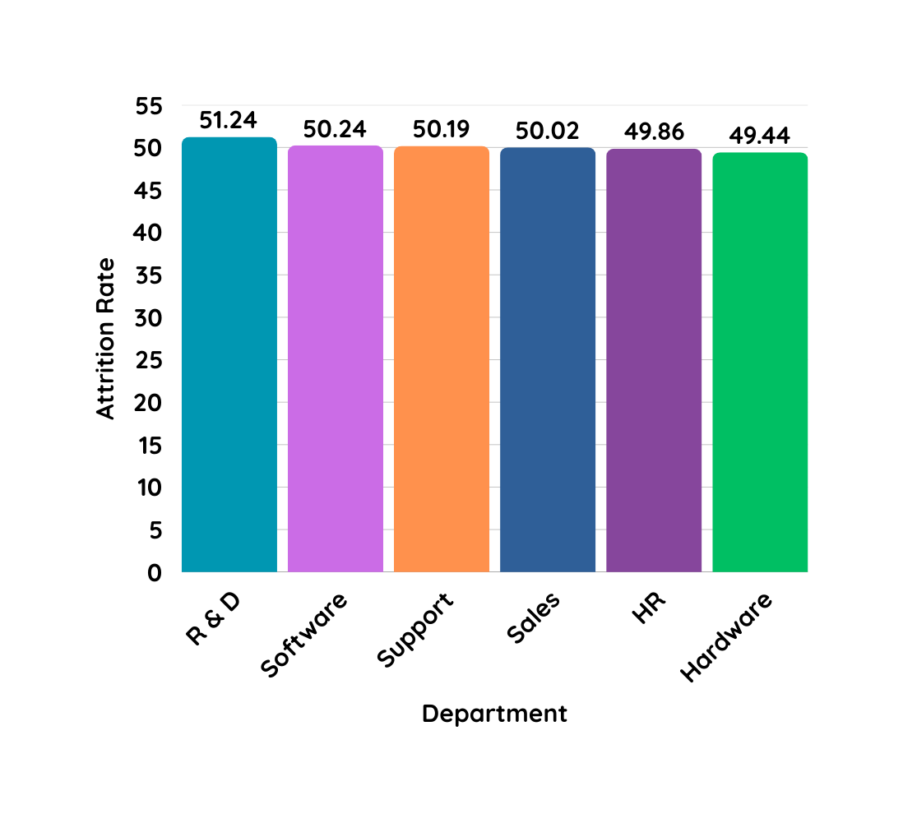
Analysis – Key Relationships
Average Attrition Rate for All Departments
Definition: Mean attrition rate calculated across all departments.
Departments with Highest Attrition: Research & Development, Software
Purpose: Identifies departmental trends—departments with consistently high attrition may need targeted HR interventions.

Slide 11
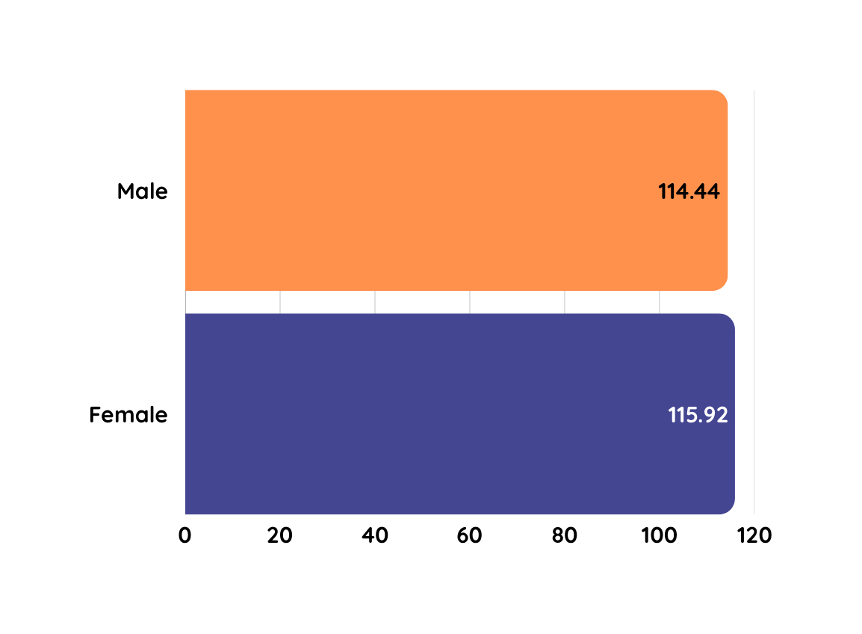
Analysis – Key Relationships
Average Hourly Rate of Research Scientists by gender
Definition: The average hourly wage paid to employees, segmented by gender.
Value: Females earn slightly more ($115.93) than males ($114.45).
Purpose: Useful for compensation analysis and gender equity reviews. Helps benchmark pay scales.

Slide 12
Analysis – Key Relationships
Attrition Rate vs. Monthly Income Stats
Definition: An analysis comparing attrition rates across various monthly income brackets.
Insight: Surprisingly stable (~50%) across brackets, suggesting income isn't a sole predictor of attrition.
Purpose: Understand whether salary influences employee retention significantly.

Slide 13
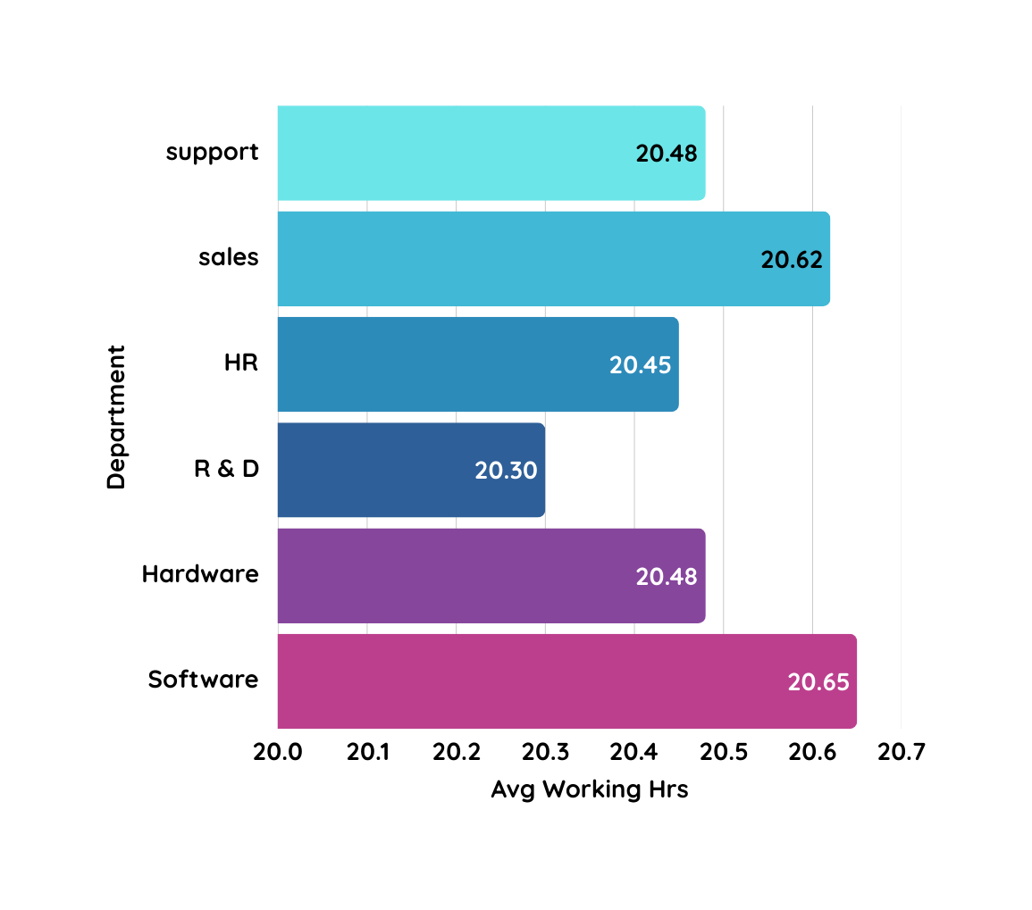
Analysis – Key Relationships
Average Working Years for Each Department
Definition: Mean number of years employees have worked in each department.
Values: Around 20.3–20.6 years across departments like Support, Software, and Sales.
Purpose: Reflects workforce experience and potential risk of aging workforce or retirement waves.

Slide 14
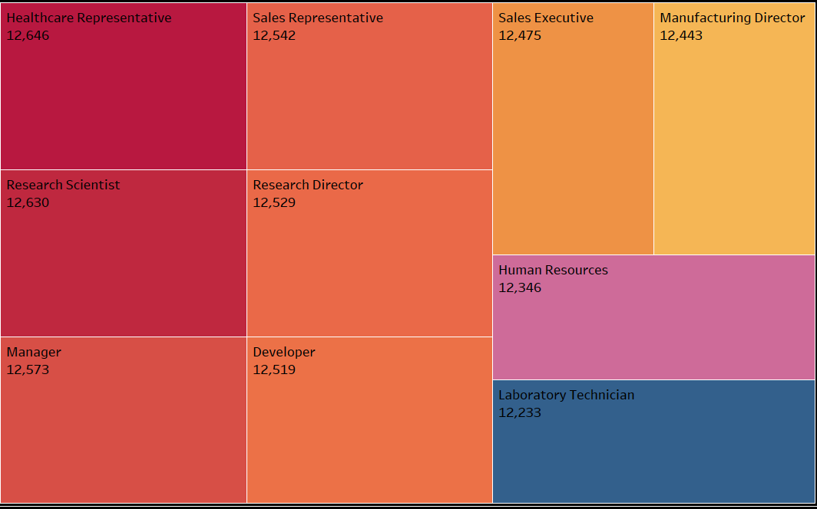
Analysis – Key Relationships
Job Role vs Work-Life Balance
Definition: An analysis of how different job roles score in work-life balance metrics.
Insight: R&D roles have better work-life balance (e.g., 12,546 hours).
Purpose: Helps HR improve work-life balance programs tailored to specific job roles.

Slide 15
Analysis – Key Relationships
Attrition Rate vs. Years Since Last Promotion
Definition: Comparison between how long it has been since the last promotion and attrition likelihood.
Key Insight: Attrition spikes to 43.11% for employees with no promotion in 4+ years.
Purpose: Indicates promotion-related stagnation as a major driver of turnover.

Slide 16

Recommendations & Insights
Improve Compensation for Lower-Income Groups
Targeted Retention for Sales & R&D
Promote Regular Career Progression
Enhance Work-Life Balance through Policy & Culture

Slide 17
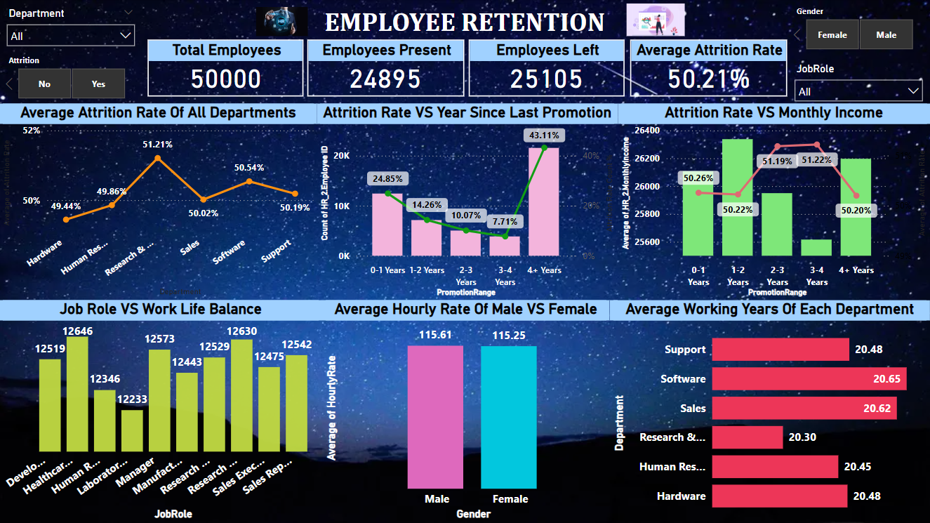
Dashboard

Slide 18
Conclusion
•HR analytics offers actionable insights to reduce attrition and boost satisfaction.
•Strategic interventions can significantly improve workforce stability and performance.

Slide 19
Thank you

